Slide 1
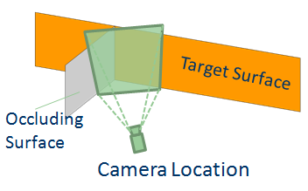
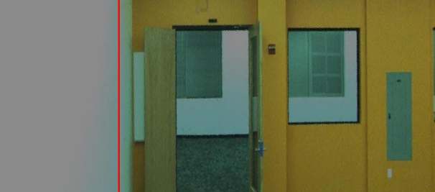
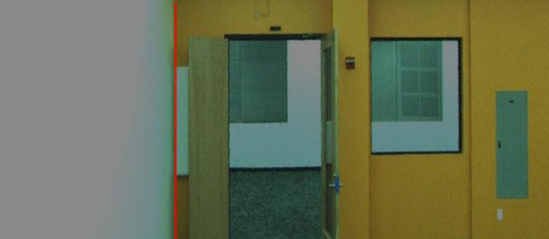
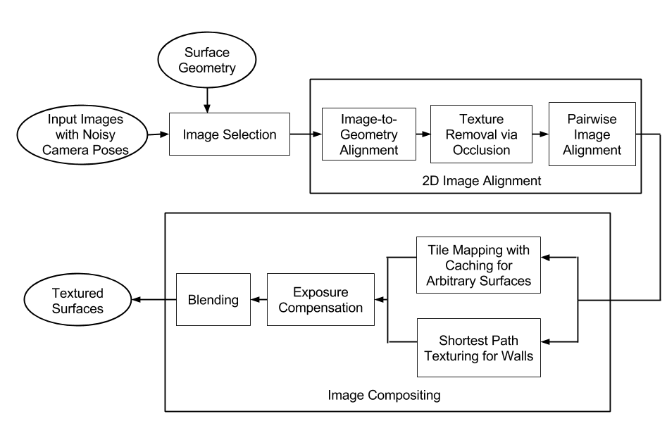
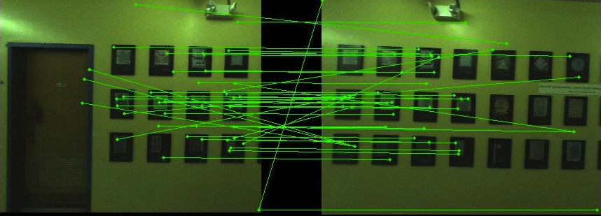
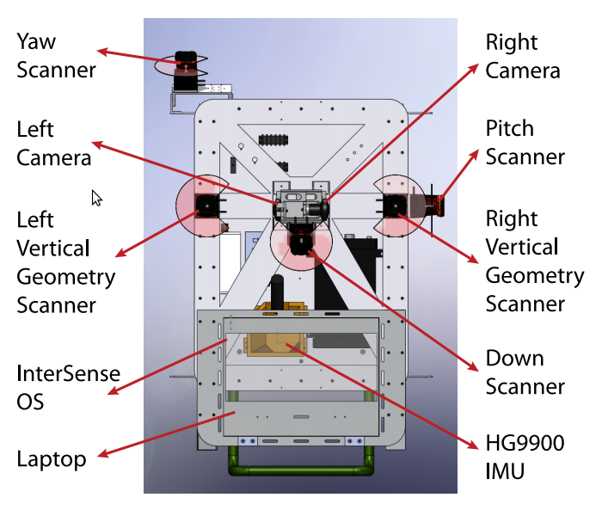
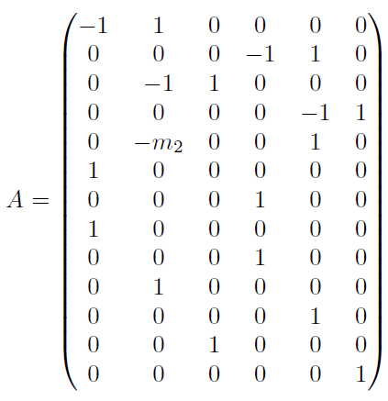
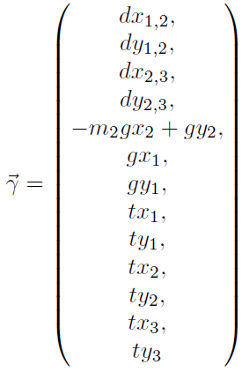
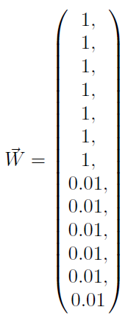
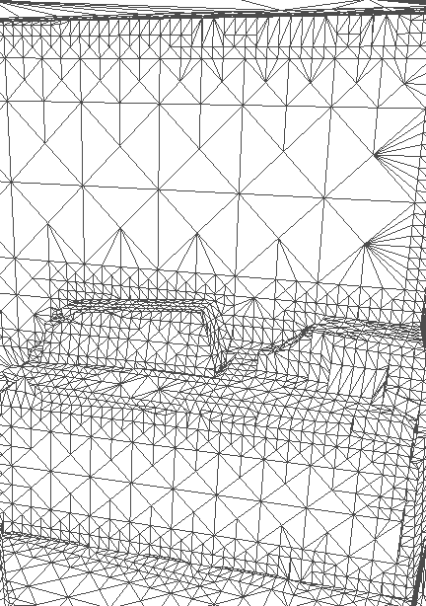
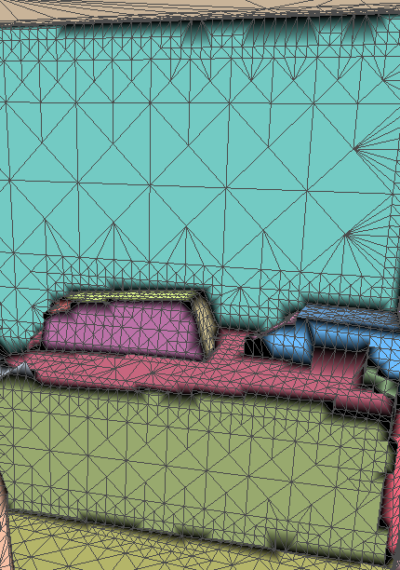
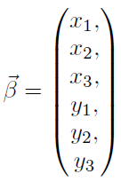
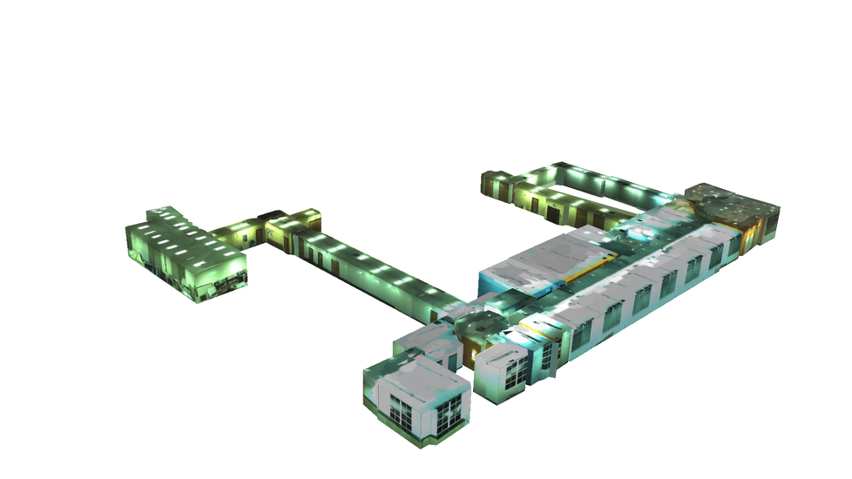
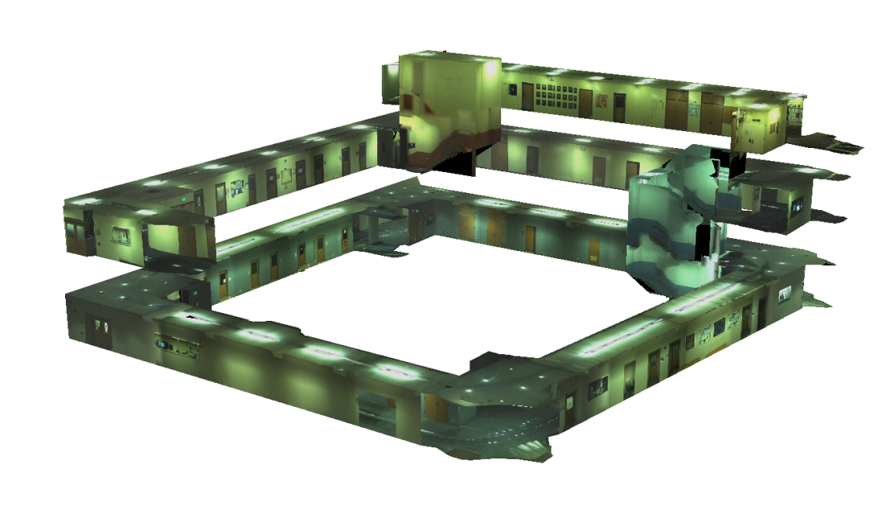
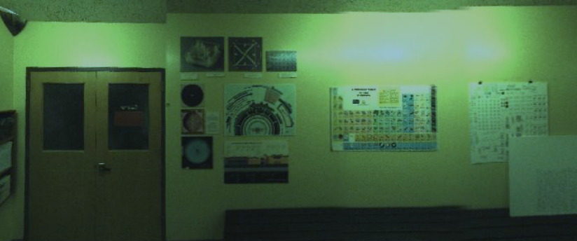
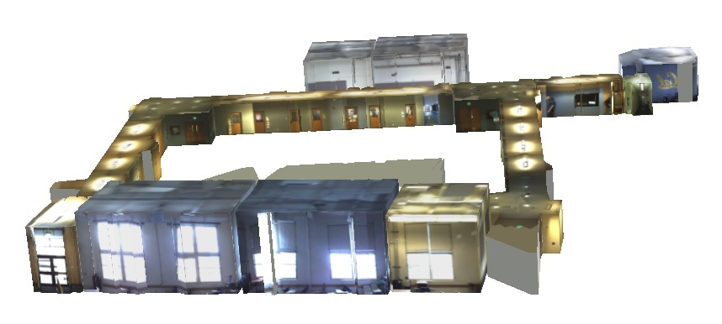
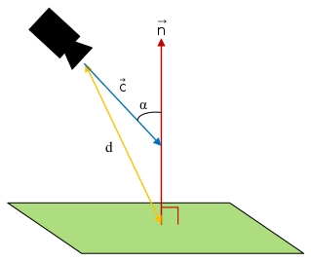
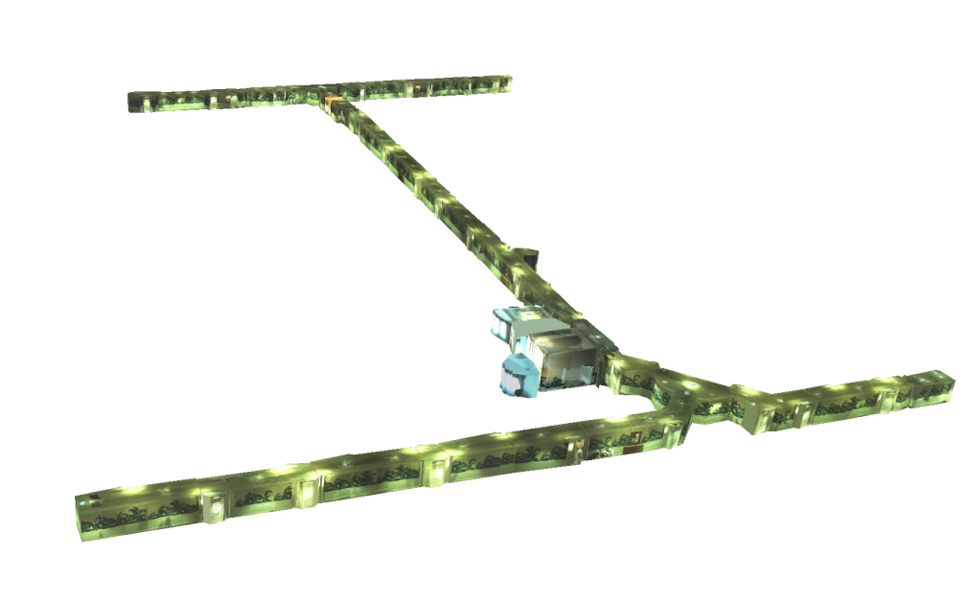
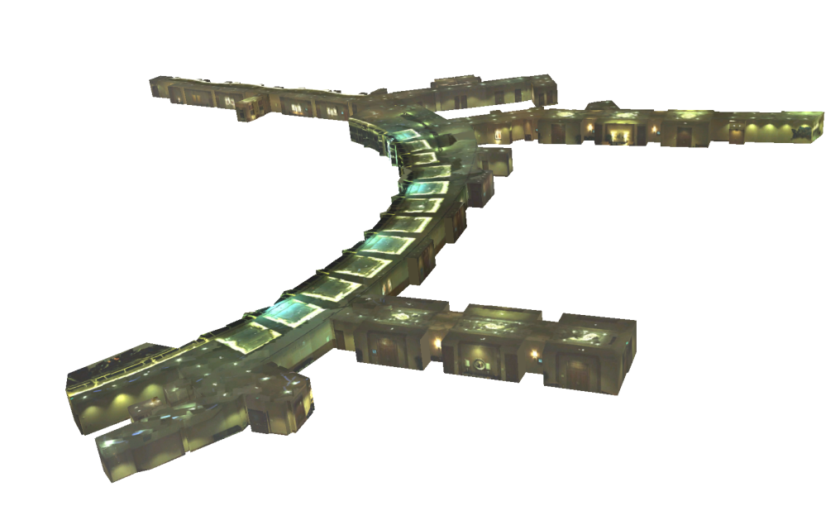
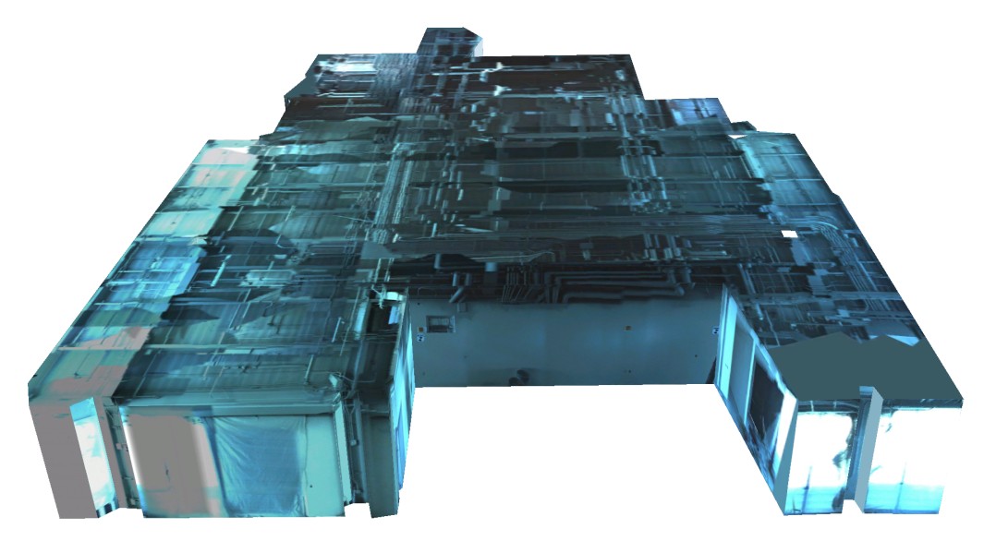
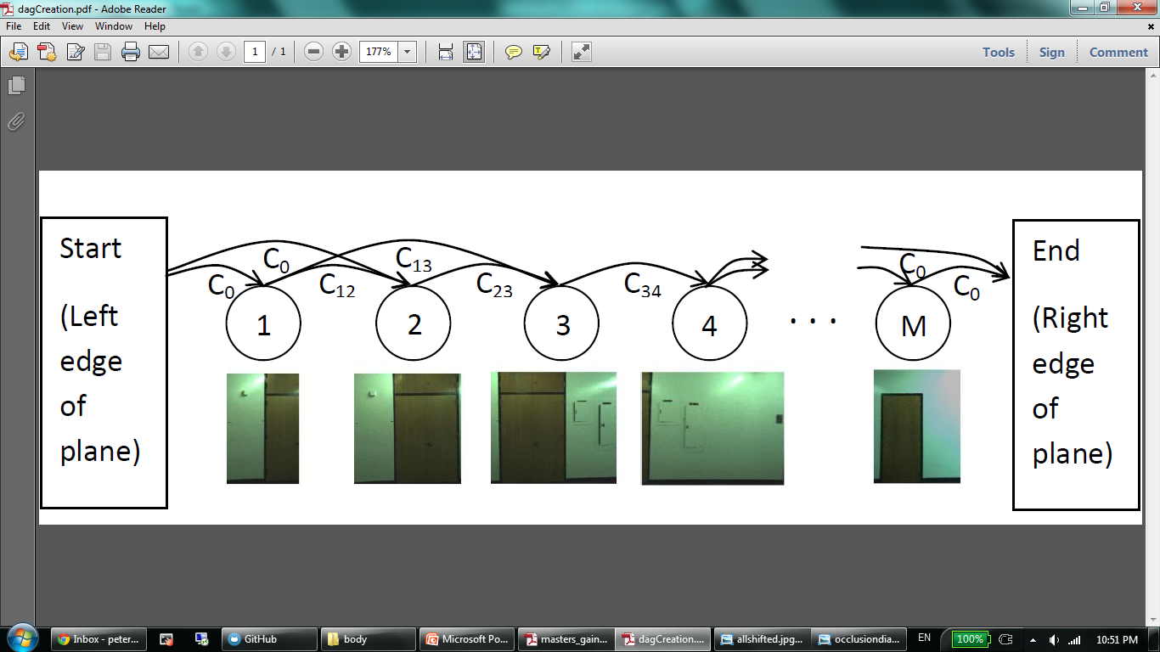
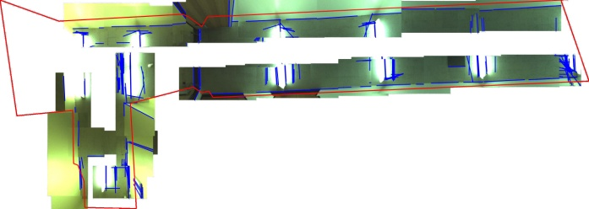
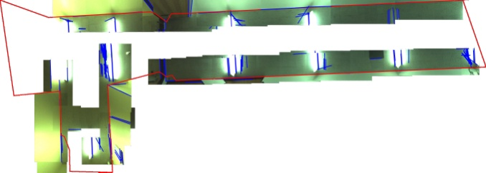
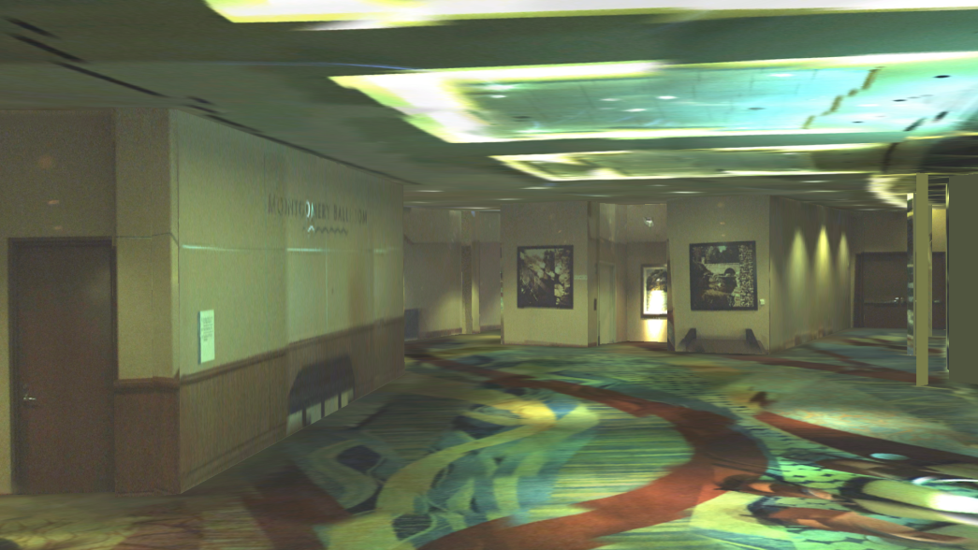
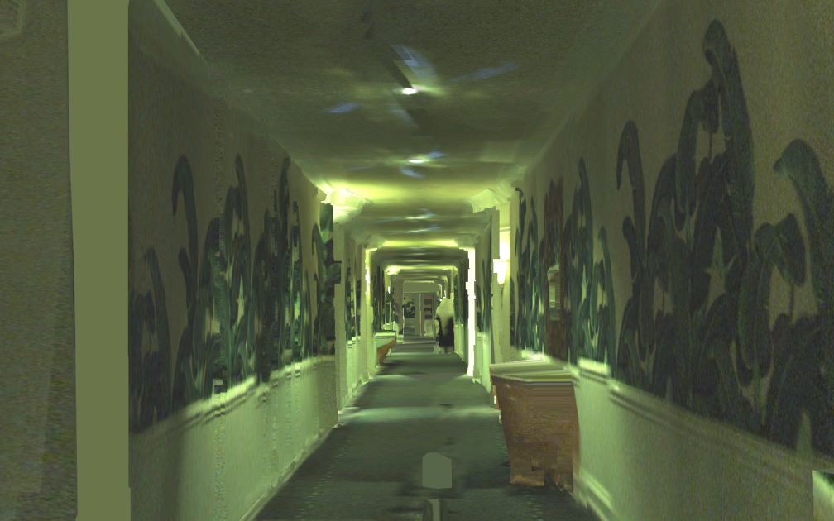
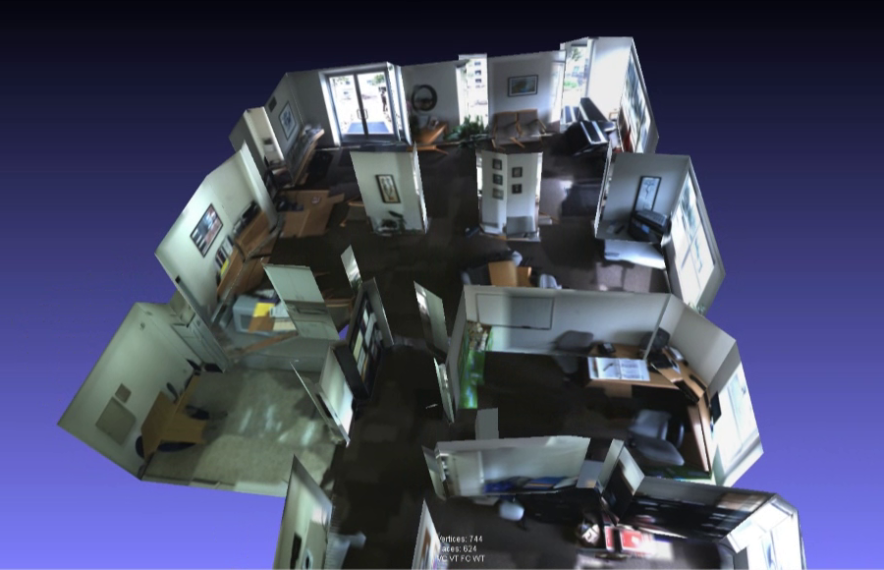
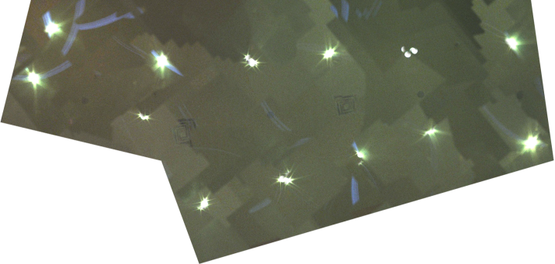
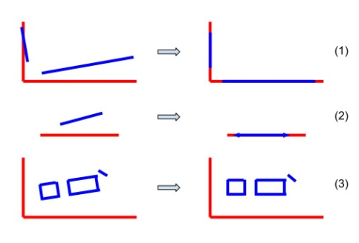
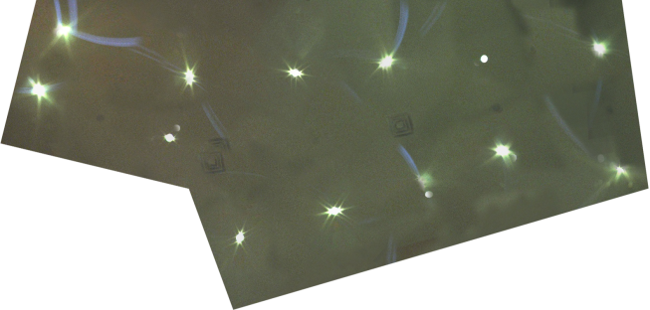
Texture Mapping 3D Models of Indoor Environment with Noisy Camera Poses
Texture Mapping Overview
Occlusion Removal
Goal:
Given approximate surface geometry and images with noisy camera poses, produce a realistic textured 3d model
Motivation:
Provide accurate 3d visualizations of interior spaces for applications such as remodeling or virtual walkthrough generation.
Selected images may contain occluding surfaces, which must be removed before images can be successfully composited together
Because of previous image-geometry alignment, occluding surfaces in imagery can be easily detected using geometry alone
Image projections are divided into a grid, with ray-polygon intersection tests performed at each corner. Fully occluded areas of the image are removed, while partially occluded areas are subdivided recursively into a smaller grid, and the process is repeated.
Peter Cheng, Michael Anderson, Stewart He, Avideh Zakhor
Video and Image Processing Lab - UC Berkeley
System Process
(See center panel)
Acquire (noisy) geometry and image data from a variety of sensors mounted upon an ambulatory backpack platform.
Partition geometry into spatially consistent regions, and acquire a set of candidate images for each region
Refine camera poses by detecting linear matches between images and geometry, as well as pairwise feature matches in images alone.
Composite images onto each region using either a tile-based or a shortest-path method, followed by exposure compensation and blending
System Layout
Pairwise Feature Matching
SIFT feature matches are detected between each pair of overlapping images.
RANSAC framework is used to obtain a robust 2d transformation from SIFT feature matches
Data Acquisition System
CAD diagram of backpack system is shown to the right
IMUs and laser scanners are used to localize backpack and generate point cloud of surrounding environment, though results are noisy [Liu et. al. 2010]
Side-facing fisheye cameras provide source imagery for texturing
Least Squares Solution
Images are related to geometry via image-geometry transforms, images are related to each other via SIFT matches, and images have noisy camera poses.
All 3 are reconciled via a weighted linear least squares problem.
Image-geometry and image-image transformation observations are given a weighting of 1.
Noisy camera poses should be used minimally, and only to constrain solution as needed, so their observations are given a weighting of 0.1
Geometry Partitioning
Models can be textured faster by splitting environment geometry into regions for independent processing
Triangular mesh is generated from point cloud. [Sanchez 2012, Turner 2012, Turner 2013]
Triangles are merged with coplanar neighbors, and then clustered spatially by relative orientation.
Results
Tile-based Image Composition
A simple, general way to composite images together is by dividing a region’s surface into tiles, and selecting an image to texture each tile
Image Selection
Best image for each tile is selected according to scoring function used in original image selection process
Texture continuity is improved by adding a spatiotemporal caching mechanism; this encourages neighboring tiles to use identical images, or images taken nearby spatially and temporally.
To texture each geometrical region, we first obtain a set of images with good viewing poses for that region
We desire a set of images that together cover the entire region, and provide high resolution imagery for the region
Split each region into rectangular tiles, and for each tile, find the image that has the best viewing angle and distance to that tile. This can be quantified by maximizing the function to the right
Shortest Path Image Composition
An optimal texture can be directly obtained by measuring and minimizing pixel differences at image boundaries
A 1-d DAG is constructed of all images, with edge costs defined by SSD of pixels in overlapping regions.
Linear Geometry Alignment
Since regions are textured independently, it is possible for textures to not line up well at region boundaries
Region boundaries occur at sharp corners, and sharp corners often correspond to strong visual features in images
Hough transforms are used to detect lines in images, and a transformation is computed to maximally match lines in images to lines formed by region boundaries and intersections
Aligning images to geometry enforces texture continuity across boundaries and indirectly matches images more accurately
Solution results in subset of images that spans entire surface with minimal pixel differences in adjacent images.
Only applies to regions with lateral coverage, e.g. walls, due to our fisheye cameras.
Exposure Compensation and Blending
Cameras have automatic exposure; this means different images of the same area can have varying brightness
Relative difference in brightness between 2 images can be found by averaging pixel offsets in overlapping regions.
Least squares problem is formed to calculate a gain for each image such that relative differences in brightness are minimized.
Alpha blending between neighboring images is added to further smooth transitions.

